Slide 1
Lecture 13a: Cloud Architecture
Selected slides credit to:
Textbook author Dan C. Marinescu
Computer Architecture: A Quantitative Approach by Hennessy and Patterson

Slide 2
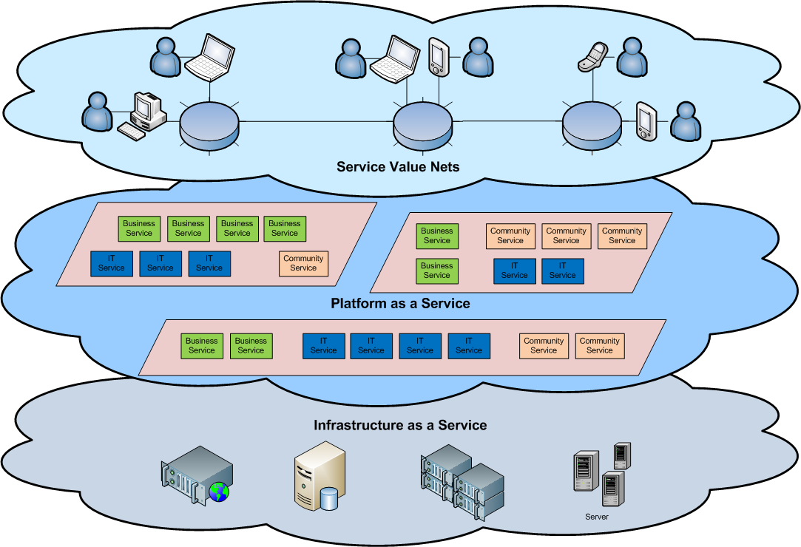
Cloud Architecture: Top-level View
Top level: users interface with SaaS services
Middle level: PaaS services; users are able to develop cloud services on that level
Bottom level: the infrastructure; users may configure and manage (an image) of their own infrastructure.

Slide 3
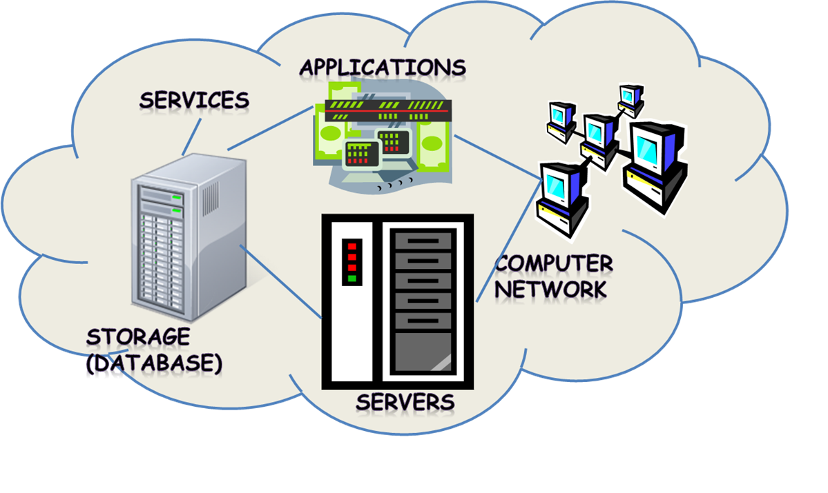
Cloud Infrastructure
Three key hardware components:
Servers
Computer Network
Storage
discussed in next lecture
Schematic Diagram
Showing servers, network and storage components.

Slide 4
Servers
High Performance Computing (HPC) Clusters
Data Centers
Warehouse Scale Computers (WSC)

Slide 5
Cloud Servers vs. Cloud Infrastructure
A cloud server is a virtual server (rather than a physical server) running in a cloud computing environment. It is built, hosted and delivered via a cloud computing platform via the internet, and can be accessed remotely.
Cloud infrastructure refers to the hardware and software components -- such as servers, storage, a network and virtualization software -- that are needed to support the computing requirements of a cloud computing model.
This lecture focuses on the “physical” layer of architecture, hence “servers” here referring to physical servers in cloud infrastructure.

Slide 6
High Performance Computing Clusters
Terminology
HPC: High performance computing
High-performance computing (HPC) is the use of parallel processing for running advanced application programs efficiently, reliably and quickly. The term applies especially to systems that function above a teraflop or 1012 floating-point operations per second.
HPCC: High performance computing cluster
A cluster of computers joins computational powers of the compute nodes to provide a more combined computational power.
An HPC cluster is made of many separate servers, called nodes, possibly filling an entire data center with dozens of power-hungry racks.
HPCC is commonly used as an infrastructure for supporting small cloud platforms, particularly private clouds.

Slide 7
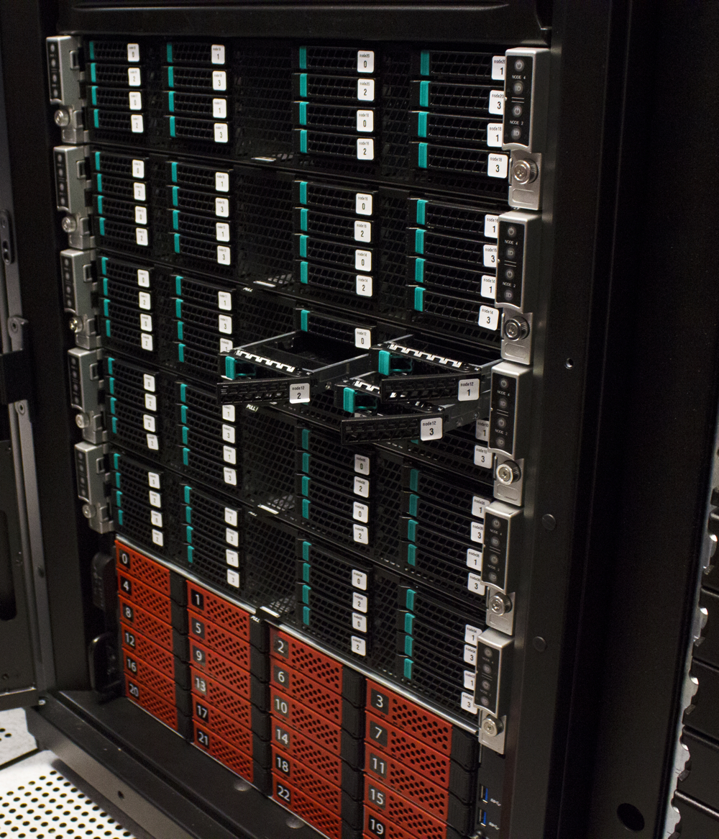
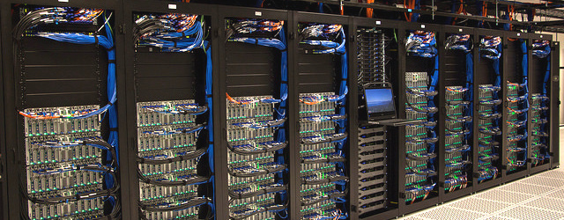
Sample HPCCs
https://www.advancedclustering.com/

Slide 8
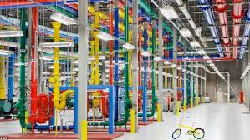
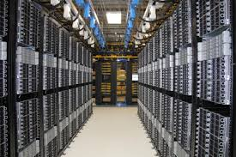
Data Centers
A data center is a building, dedicated space within a building, or a group of buildings used to house computer systems and associated components, such as telecommunication networks and storage systems.
Along with the advancement of cloud computing, large scale data centers equipped with more than ten thousands of servers are booming in recent years.
Google, Facebook, Amazon, Alibaba, … have opened many data centers recently.
https://www.computerworld.com/

Slide 9
Data Center: Key Characteristics
High Availability
Maintain fault tolerance, avoid downtime even during maintenance and upgrades, …
Modularity and flexibility
Allow for a data center to grow and change over time
Environmental control
Energy efficiency (cooling, airflow, low-voltage cable routing, …)
High utilization
Use virtualization to reduce the demand for physical devices
Automation
24x7 remote controlled
Security
Physical access is usually restricted, access control at every layer.
Key: high performance and energy efficiency

Slide 10
Warehouse-Scale Computer (WSC)
Provides Internet services.
Search, social networking, online maps, video sharing, online shopping, email, cloud computing, etc.
It is a type of datacenter.
WSCs currently power the services offered by companies such as Google, Amazon, Facebook, and Microsoft’s online services division.
WSC Reference: Barroso and Holzle (Google) The Datacenter as a Computer; An Introduction to the Design of Warehouse-Scale Machines [2009]

Slide 11
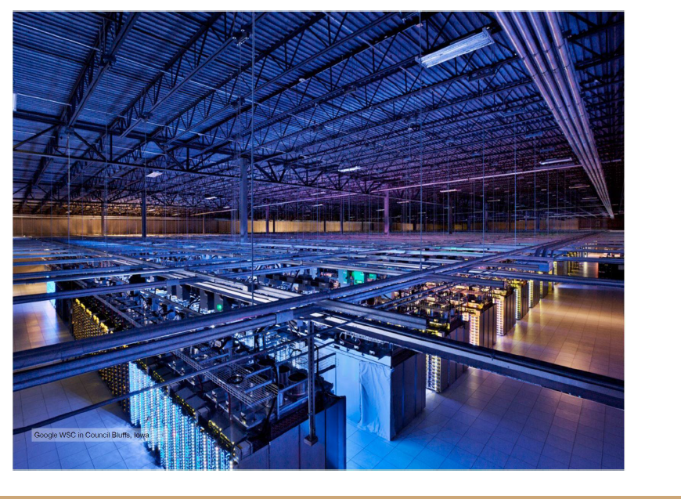
What is WSC
Warehouse-scale Computer
A warehouse full of computers
Originated from data center
More powerful than traditional data center
Large portions of the hardware and software resources in these facilities must work in concert to efficiently deliver good levels of Internet service performance
Emphasis: cost effective
A Sample WSC
https://www.laserfocusworld.com/

Slide 12
Overview of WSC
Warehouse-scale computer (WSC)
Provides Internet services
Search, social networking, online maps, video sharing, online shopping, email, cloud computing, etc.
A today’s typical WSC
One giant machine with capital cost ~150M
Connects and houses 50K – 100K servers
WSCs vs. Supercomputers
WSC: target at providing information technology for the world
Supercomputer: providing high-performance computing for scientists and engineers

Slide 13
WSC vs. Clusters and Datacenters
WSC: an extremely large cluster
Differences with HPC “clusters”
Clusters have higher performance processors and network
Clusters emphasize thread-level parallelism, WSCs emphasize request-level parallelism
Differences with datacenters
Datacenters consolidate different machines and software into one location
Datacenters emphasize virtual machines and hardware heterogeneity in order to serve varied customers

Slide 14
WSC vs. Traditional Data Center
Traditional datacenters, however, typically host a large number of relatively small- or medium-sized applications, each running on a dedicated hardware infrastructure that is de-coupled and protected from other systems in the same facility.
Different computing systems within such a datacenter often have little in common in terms of hardware, software, or maintenance infrastructure, and tend not to communicate with each other at all.
A WSC usually belongs to a single organization, use a relatively homogeneous hardware and system software platform, and share a common systems management layer. Often, much of the application, middleware, and system software is built in-house compared to the predominance of third-party software running in conventional datacenters.

Slide 15
Activity #1
True or False
An HPC cluster usually takes spaces of one or several buildings.
A WSC is an extremely large HPC cluster.
A data center may host several different HPC clusters.
2. Name a data center close to your region.
3. Describe the computing cluster in your university/department (what kind of computing, storage, and network configurations etc.)

Slide 16
Important Design Factors for WSC
Cost-performance
Small savings add up
Energy efficiency
Affects power distribution and cooling
Dependability via redundancy
Network I/O
Interactive and batch processing workloads
Ample computational parallelism is not a problem
Most jobs are totally independent
Operational costs count
Power consumption is a primary, not secondary, constraint when designing system
Scale and its opportunities and problems
Can afford to build customized systems since WSC require volume purchase

Slide 17
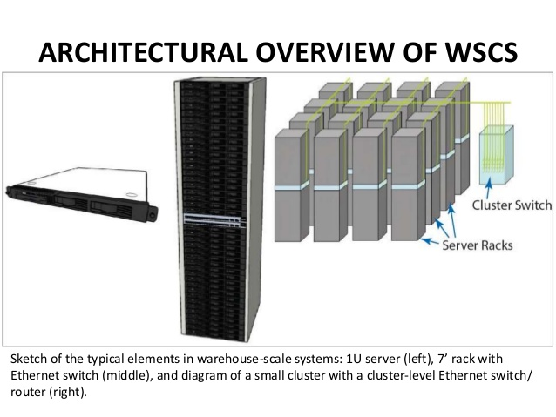
Computer Architecture of WSC
WSCs use a hierarchy of networks for interconnection, similar to memory hierarchy of a computer (Low level, high level).
Example: Each 19” rack holds 48 1U servers connected to a rack switch
Hardware and units of WSC include:
Hardware
Servers
Racks
Commodity Rack Switches
Array Switches
Units
Arrays (grouping of racks)
Rack Units (U)
https://www.semanticscholar.org/

Slide 18
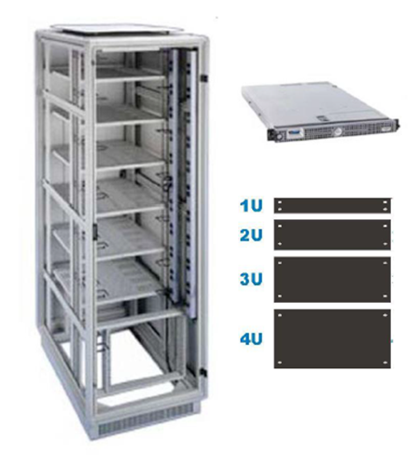
Racks
The standard since 1930s
19-inch (48.26-cm) rack
Servers measured in number of rack, units (U) they occupy (1U, 2U, etc.)
One U is 1.75 inches (4.45 cm) high
A typical 7-foot rack offers 48 U
48-port Ethernet Switch
Commodity HW
costs as low as $30 per port for a 1Gbit/sec Ethernet link in 2011
Rack switches are uplinked to switch higher in hierarchy
Uplink has 48 / n times lower bandwidth
where n = # of uplink ports
Goal: to maximize locality of communication relative to the rack

Slide 19
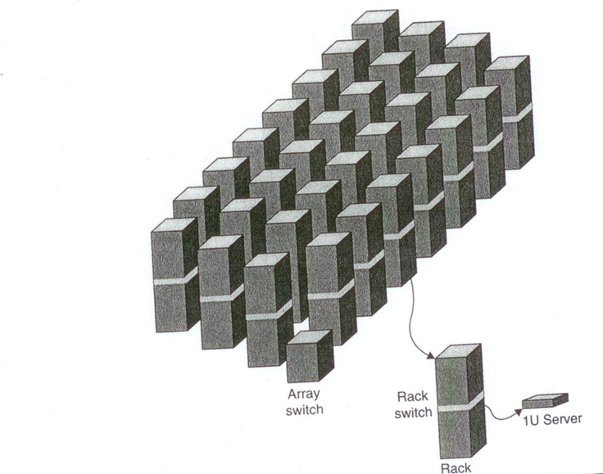
Switches
WSC use a hierarchy of networks
Rack Switch
Located within a rack
48-port Ethernet switch connected to up to 48 1 U servers in the rack
Bandwidth within rack is same for each server
2 to 8 uplinks to the next higher switch in the network hierarchy
“Oversubscription” is the ratio between the internal bandwidth and uplink bandwidth
Ex: 48/2 to 48/8

Slide 20
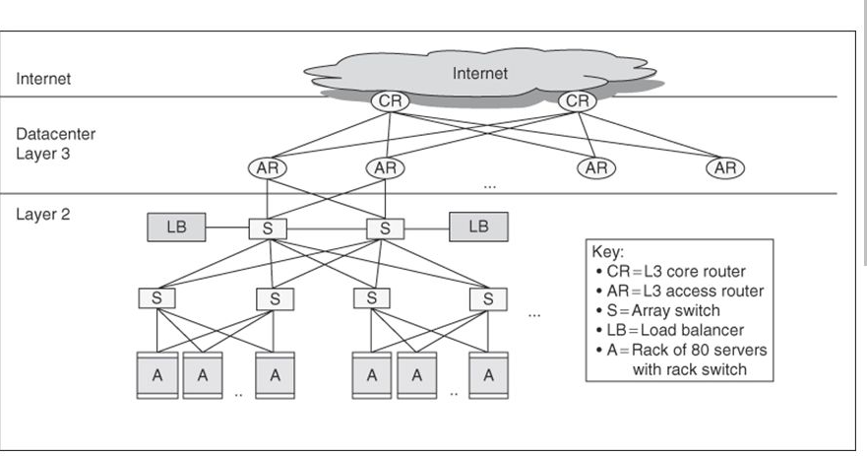
Array Switch
Switch that connects an array of racks
Connects up to 30 racks
Much more expensive than rack switch
Higher connectivity
Needs bandwidth to overcome oversubscription (slower)
Manufacturer included features
Packet Inspection
Content addressable memory chips
Cost of switch bandwidth for n ports can grow as n²
Ex: Switch that has 10x bisection bandwidth of rack switch costs 100x as much.
Often utilize content addressable memory chips and FPGAs
Layers of array switches connecting racks of servers to internet via access routers.

Slide 21
Storage
Natural design: fill rack with servers minus space for rack switch
Storage options
Use disks inside the servers, or
Network attached storage (NAS) through Infiniband
WSCs generally rely on local disks
Goal: maximize locality
Ex: Google File System (GFS) uses local disks and maintains at least 3 replicas.

Slide 22
WSC Memory Hierarchy

Slide 23
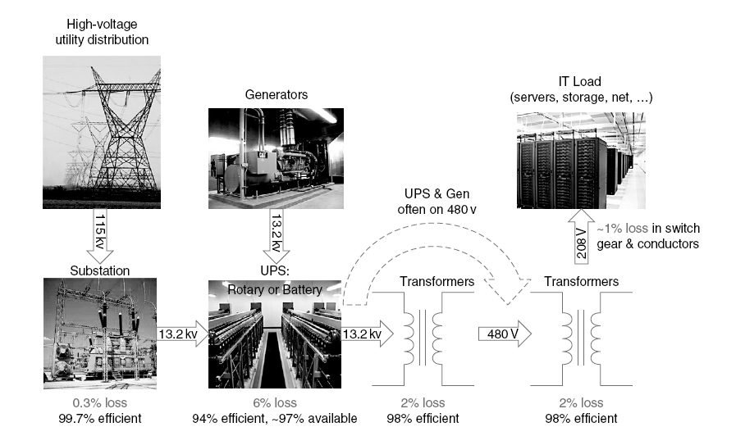
Infrastructure and Costs
Location of WSC
Proximity to Internet backbones, electricity cost, property tax rates, low risk from earthquakes, floods, and hurricanes
Two important factors
Supplying power
Cooling
Power distribution – reference (2)

Slide 24
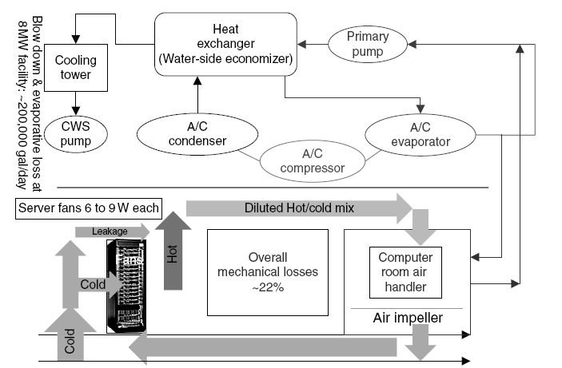
Infrastructure and Costs
Cooling
Computer room
Air-conditioning units
Cools room by pushing warm air across coils with cool water
Warm water gets cooled by external chillers
Cooling Towers
Uses outside air to cool water
Improve efficiency by running server at higher temperature
Run above 71 F (22 C)
Cooling – reference (2)

Slide 25
Infrastructure and Costs
Cooling system also uses water (evaporation and spills)
E.g. 70,000 to 200,000 gallons per day for an 8 MW facility
Power cost breakdown:
Chillers: 30-50% of the power used by the IT equipment
Air conditioning: 10-20% of the IT power, mostly due to fans
How many servers can a WSC support?
Each server:
“Nameplate power rating” gives maximum power consumption
To get actual, measure power under actual workloads
Oversubscribe cumulative server power by 40%, but monitor power closely

Slide 26
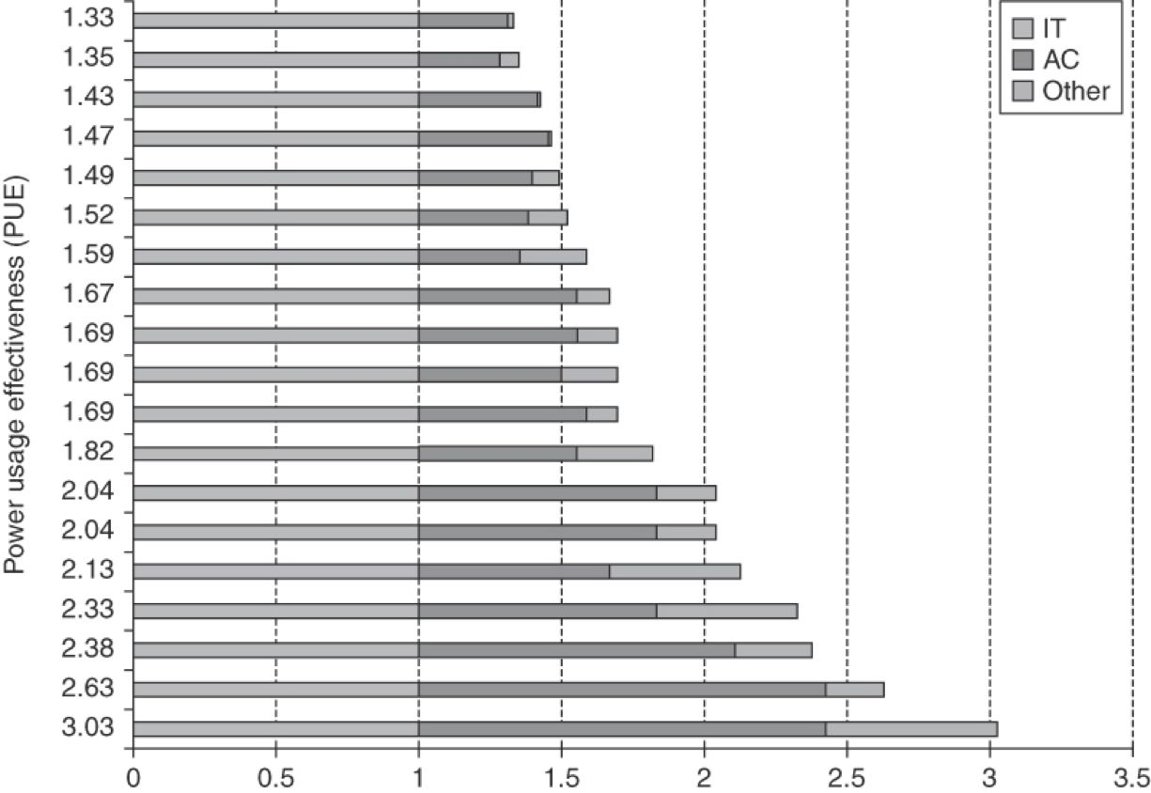
Measuring Efficiency of a WSC
Power Utilization Effectiveness (PEU) PEU = Total facility power / IT equipment power
PUE value should be 1 and greater
More than half of overhead is for cooling
Median PUE on 2006 study was 1.69
Performance
Latency is important metric because it is seen by users
Bing study: users will use search less as response time increases
Service Level Objectives (SLOs)/Service Level Agreements (SLAs)
E.g. 99% of requests be below 100 ms
Reference (2)

Slide 27
Cost of a WSC
Capital expenditures (CAPEX)
Cost to build a WSC which includes the building, power and cooling infrastructure, and initial IT equipment (servers and networking equipment).
Operational expenditures (OPEX)
Cost to operate a WSC which includes buying replacement equipment, electricity, and salaries.

Slide 28
Case Study: Google WSC
Started working in Nov. 2005
45 40-foot-long modified server containers
300’ x 250’ space (~75000 ft2)
Location not revealed
Separated hot and cold chambers to reduce variation in air temperature, which allows air to be delivered at higher temperatures due to less severe worst-case hot spots.
Operating servers at higher temperatures allowed use of cooling towers instead of the inefficient traditional chillers.
Shrunk distance of air circulation loop to reduce energy required to move air.
Deployed extensive monitoring to measure actual PUE.
Designed motherboards that only need a single 12-volt supply so that a UPS could be provided using standard batteries with each server.
Google PUE was 1.23 in 2007 and was 1.12 in 2011

Slide 29
Networks

Slide 30
Clouds and Networks
Unquestionably, communication is at the heart of cloud computing.
Interconnectivity supported by a continually evolving Internet made cloud computing feasible.
A cloud is built around a high-performance interconnect, the servers of a cloud infrastructure communicate through high-bandwidth and low-latency networks.
Cloud workloads fall into four broad categories based on their dominant resource needs:
CPU-intensive, memory-intensive, I/O-intensive, and storage-intensive.
While the first two benefit from, but not do not require, high-performing networking, the last two do.
Networking performance directly impacts the performance of I/O- and storage-intensive workloads
The designers of a cloud computing infrastructure are acutely aware that the communication bandwidth goes down and the communication latency increases the farther from the CPU data travels.

Slide 31
Selected review of fundamental network concepts
The relation of Internet networks based on the transit and paying settlements. There are three classes of networks, Tier 1, 2, and 3; an IXP is a physical infrastructure allowing ISPs to exchange Internet traffic. Figure 5.4 of textbook.

Slide 32
Interconnection networks for computer clouds
While processor and memory technology have followed Moore's Law, interconnection networks have evolved at a slower pace.
From 1997 to 2010 the speed of the ubiquitous Ethernet network has increased from 1 to 100 Gbps. This increase is slightly slower than the Moore's Law for traffic which predicted, 1 Tbps Ethernet by 2013.
Interconnection networks are a major factor in determining the overall performance and cost of the system.
Fat-tree topology is popular for cloud computing and widely employed in cloud infrastructures usually using InfiniBand network technology as their foundation

Slide 33
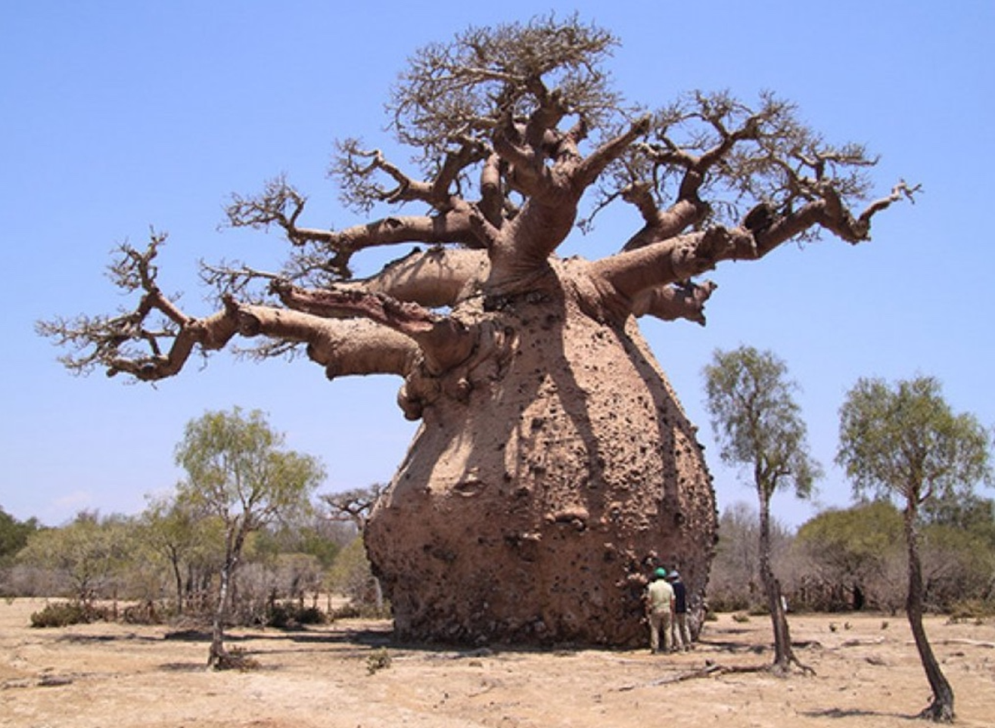
Fat trees
Fat-Tree networks were proposed by Charles E. Leiserson (MIT) in 1985. Optimal interconnects for large-scale clusters and for WSCs.
Servers are placed at the leafs.
Switches populate the root and the internal nodes of the tree.
Have additional links to increase the bandwidth near the root of the tree.
A fat-tree network can be built with cheap commodity parts as all switching elements of a fat-tree are identical.
Figure 5.10 of textbook

Slide 34
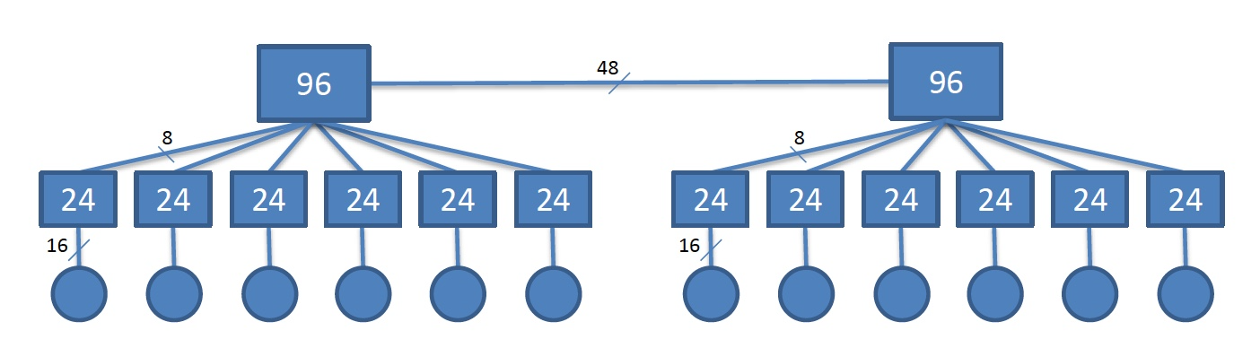
Fat-tree Example 1
A 192 node fat-tree interconnection network with two 96-way and twelve 24-way switches in a computer cloud. The two 96-way switches at the root are connected via 48 links. Each 24-way switch has 6 x 8 uplink connections to the root and 6 x 16 down connections to 16 servers.

Slide 35
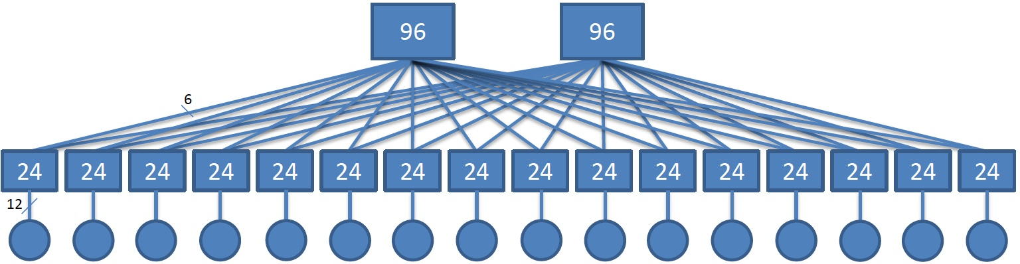
Fat-tree Example 2
A192 node fat-tree interconnect with two 96-way and sixteen 24-way switches. Each 24-way switch has 2 x 6 uplink connections to the root and 12 down connections to 12 servers.
Figure 5.11 of textbook

Slide 36
InfiniBand
Interconnection network used by supercomputers and computer clouds.
Has a switched fabric topology designed to be scalable.
Offers point-to-point bidirectional serial links intended for the connection of processors with high-speed peripherals, such as disks, as well as multicast operations.
InfiniBand supports:
Quality of service guarantees.
Failover - the capability to switch to a redundant or standby system.
The data rates.
single data rate (SDR) - 2.5 Gbps in each direction per connection.
double data rate (DDR) - 5 Gbps.
quad data rate (QDR) – 10 Gbps.
fourteen data rate (FDR) – 14.0625 Gbps.
enhanced data rated (EDR) – 25.78125 Gbps.
Advantages.
high throughput, low latency.
supports quality of service guarantees and failover - the capability to switch to a redundant or standby system

Slide 37
Storage Area Networks (SANs)
Specialized, high-speed network for data block transfers between computer systems and storage elements.
Consists of a communication infrastructure and a management layer.
The Fiber Channel (FC) → dominant architecture of SANs.
FC → a layered protocol.
A storage area network interconnects servers to servers, servers to storage devices, and storage devices to storage devices.
Figure 5.14 of textbook

Slide 38
Data Center Networks (DCNs)
Challenges :
Aggregate cluster bandwidth scales poorly with cluster size.
Bandwidth needed by many cloud applications comes at a high price.
The cost increases dramatically with cluster size.
Communication bandwidth may become oversubscribed by a significant factor depending on the communication patterns.
DCN architectural styles:
Three-tier → multiple-rooted tree topology with three layers, core, aggregate, and access. The architecture is not suitable for computer clouds, it is not particularly scalable, the bisection bandwidth is not optimal; switches at the core layer are expensive and power-hungry. Servers are directly connected to switches at the leafs of the tree at the access layer.
Fat-tree → optimal for computer clouds, the bandwidth is not severely affected for messages crossing multiple switches and interconnection network can be built with commodity, rather than enterprise switches.

Slide 39
Fat-tree DCNs
Design principles:
The network should scale to a very large number of nodes.
The fat-tree should have multiple core switches.
The network should support multi-path routing. The equal-cost multi-path (ECMP) routing algorithm which performs static load splitting among flows should be used.
A WSC interconnect consists of k pods;
Each pod has two layers and k/2 switches at each layer.
Each switch at the lower layer is connected directly to k/2 servers. The other k/2 ports are connected to k/2 of the k ports in the aggregation layer.
The total number of switches is k(k+1) and the total number of servers connected to the system is k². There are (k/2)² paths connecting every pair of servers.
Example
Next slide

Slide 40
Figure 5.17 of textbook
Fat-tree interconnection network for k=4. The core, the aggregation, and the edge layers are populated with 4-port switches. Each core switch is connected with one of the switches at the aggregation layer of each pod.
The network has four pods, there are four switches at each pod, two at aggregation layer and two at the edge. Four servers are connected to each pod.

Slide 41
Content Delivery Networks (CDNs)
CDNs are designed to support scalability, to increase reliability and performance, and to provide better security.
Internet video is expected to generate over 18 exabytes of data per month. (2013 data)
A CDN receives the content from an origin server, then replicates it to its edge cache servers; the content is delivered to an end-user from the “closest” edge server.
A CDN can deliver static content and/or live or on-demand streaming media.
Static content - media that can be maintained using traditional caching technologies as changes are infrequent. Examples: HTML pages, images, documents, software patches, audio and video files.
Live media - live events when the content is delivered in real time from the encoder to the media server.
Protocols used by CDNs: Network Element Control Protocol (NECP), Web Cache Coordination Protocol (WCCP), SOCKS, Cache Array Routing Protocol (CARP), Internet Cache Protocol (ICP), Hypertext Caching Protocol (HTCP), and Cache Digest.

Slide 42
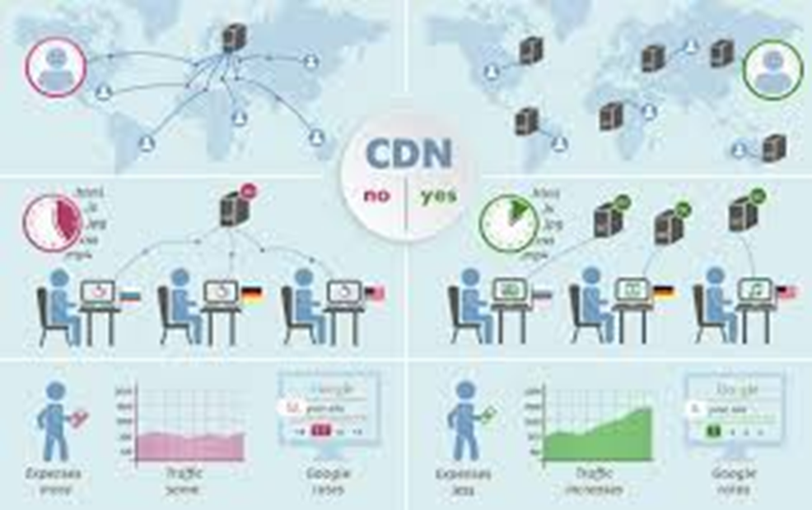
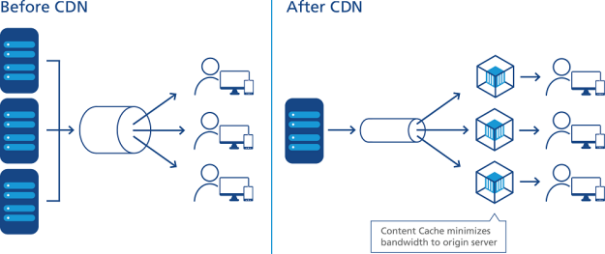
Before CDN vs After CDN: illustrations
The difference is with CDN a bunch of servers geographically positioned between the origin server of some web content. When the user requesting the service via CDN servers, the content will be delivered faster by reducing latency.
Same principle as the left figure and here you will see with a bunch of CDN servers the performance (green chart with CDN vs. pink chart without CDN) increases.
https://www.id.ntt.com/en/services/network/cdn.html

Slide 43
CDN Design and Performance
Design and policy decisions for a CDNs.
The placement of the edge servers.
The content selection and delivery.
The content management.
The request routing policies.
Critical metrics for CDN performance
Cache hit ratio - the ratio of the number of cached objects versus total number of objects requested.
Reserved bandwidth for the origin server.
Latency - based on the perceived response time by the end users.
Edge server utilization.
Reliability - based on packet-loss measurements.

Slide 44
Overlay and Scale-free Networks
An overlay network, or a virtual network, is a network built on top of a physical network.
The nodes of an overlay network are connected by virtual links which could traverse multiple physical links.
Overlay networks are widely used in many distributed systems such as peer-to-peer systems, content-delivery systems, and client-server systems; in all these cases, the distributed systems communicate through the Internet.
Scale-free networks
The degree distribution of scale-free networks follows a power law.
Many physical and social systems are interconnected by a scale-free network. Empirical data available for power grids, the web, the citation of scientific papers, or social networks confirm this trend.
The majority of the vertices of a scale-free network:
Are directly connected with the vertices with the highest degree.
Have a low degree and only a few vertices are connected to a large number of edges.

Slide 45
A scale-free network is non-homogeneous; the majority of vertices have a low degree and only a few vertices are connected to a large number of edges; the majority of the vertices are directly connected with the highest degree ones.
https://medium.com/

Slide 46
Activity #2
What are the advantages of fat-tree networks?
What does DCN stand for? What does CDN stand for?
Describe how CDN improves performance.

Slide 47
Summary
Architecture for supporting cloud computing
Servers, networks, …
Some contents require strong background in computer architecture and networks
Next Lecture
Cloud storage

